Slide 1
Forward model
08/21/2023
Yu Li

Slide 2
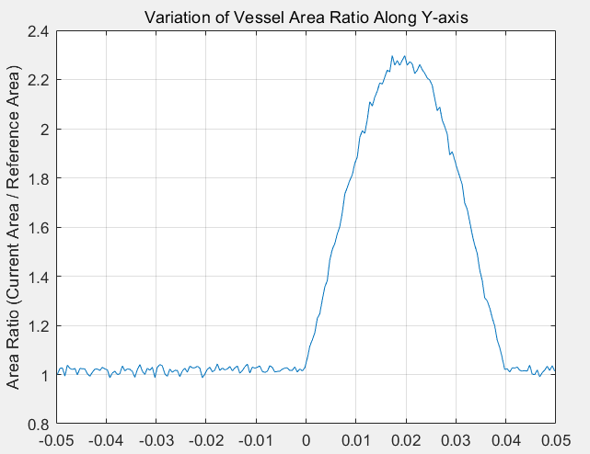
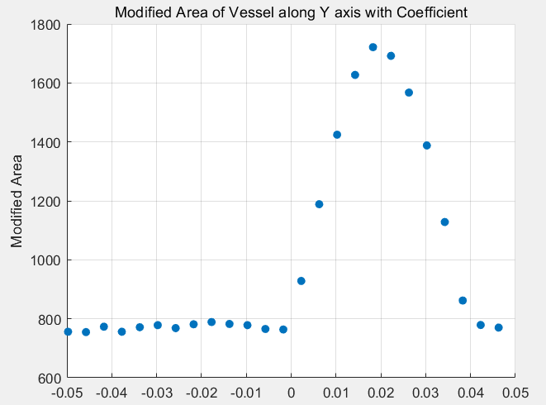
Sequential modeling
The shape of the vessel model has been improved considering that vessels are not all smooth.
Along the Y-axis, the cross-sectional area is scanned with the starting point as the baseline, and the temporal change trend of the blood vessel cross-section is obtained.
In order to avoid the data being too large, the sampling method is used to extract the model information

Slide 3
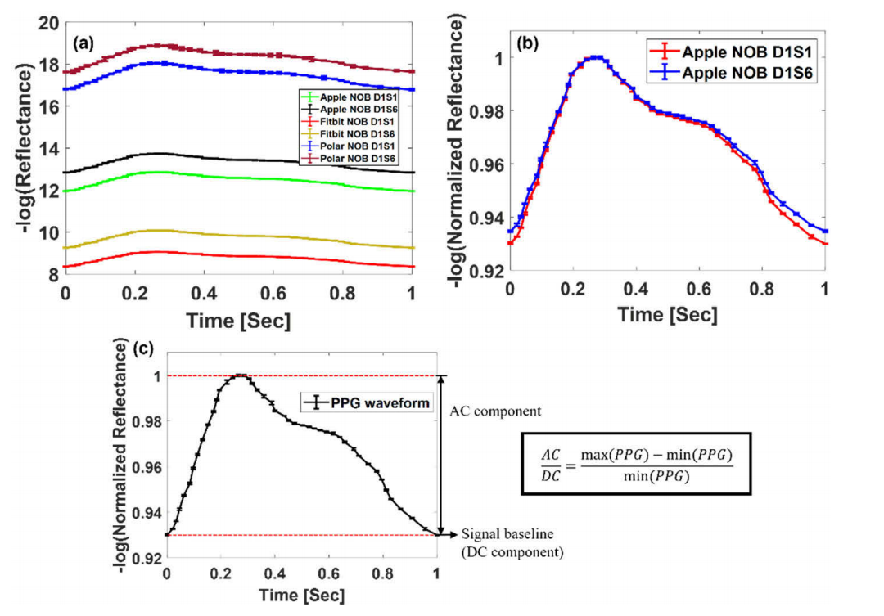
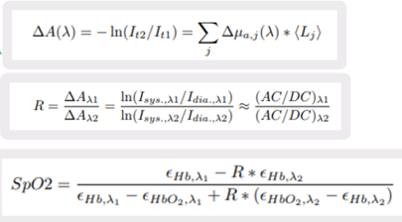
AC/DC relationship between different signals
Different AC/DC signals need to be converted and evaluated.
Reference: Monte Carlo analysis of optical heart rate sensors in commercial wearables: the effect of skin tone and obesity on thephotoplethysmography (PPG) signal
https://doi.org/10.1364/BOE.439893

Slide 4
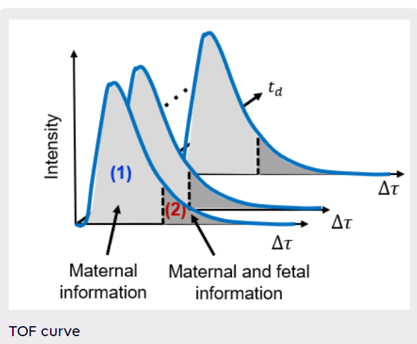
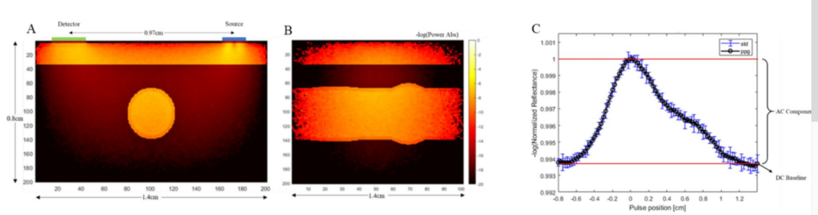
Fitting Neural Network
Forward: The TOF curve is obtained from the model through Monte Carlo simulation.
Reverse: The position of the corresponding section of the model is fitted by the TOF curve, so as to obtain the parameters.

Slide 5
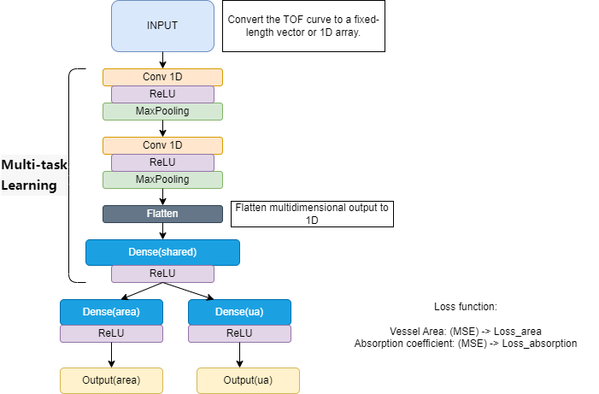
Multi-task Learning Neural Network

Slide 6
Adaptive filter
When maternal signal is known, the mixed signal can be separated by adaptive filtering:
LMS (Least Mean Squares)
RLS (Recursive Mean Squares)
If the maternal signal is also difficult to extract:
ICA (Independent Compontent Analysis)
The specific algorithm model is FastICA, which is often used for blind source separation.

